Slide 1
Global Strategic Sourcing Overview
Sonoco Vendor Conference
November 30, 2000

Slide 2
Mission
Continually and tangibly lower Enron’s overall total cost of ownership while enhancing service quality.
Facilitate new opportunities for Enron’s business units.
Rationalize Enron’s supplier base including development and utilization of minority/women business enterprises.
Provide process improvements and technology solutions that cost effectively enable and enhance the entire Supply Chain.
Foster knowledge transfer across the enterprise on all facets of Global Strategic Sourcing.

Slide 3

Planning through Payment
Standards
Planning
Sourcing
Enron
Performance
Process
and
Platforms
Diversity
Vendor
Performance
Negotiation
Execution

Slide 4
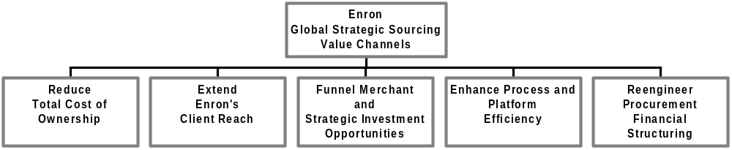
Value Channels
Sourcing Teams
Cross-Sell
Extend Sourcing Leverage
iBuyit.com
GetThere.com
SAP Interface
Trade Credits
Pay for use not asset

Slide 5
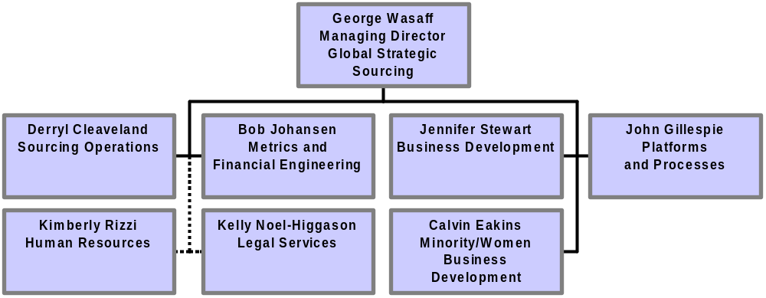
Organization

Slide 6
Three Step Cross-Selling Process
Identify opportunity
Coordinate internally
Execute
“Push” from
buy side
- OR -
“Pull” from
sell side
Agree on game plan/ communicate
Initiate contacts
Negotiate with contacts
Manage relationship
Objective
Who?
Screen current prospective suppliers for sales opportunity
GSS Origination leads analysis based on BU criteria
Cross-check current customers/ targets vs. supplier list
BUs lead analysis as part of sales qualification process using GSS supplier data
Reach internal consensus on cross-sell objectives
GSS Origination facilitates meeting/ agreement on approach
Make right contacts at right levels at right time
GSS arranges
BU introduction
to supplier VP’s
GSS coordinates
Enron players
either BU or GSS may take lead in sales calls, present- ations
Negotiate best deal on both buy and sell side (win/win)
Independently done; link only as needed
Execute and measure agreed terms
Improve build on relationships
Independently done; link only as needed

Slide 7
Target Opportunity Process
Define Planning
Objectives
Request &
Evaluate
Spend Data
Request &
Evaluate
Budget Data
Capture
End-User
Preferences
and Ideas
Analyze
Supplier Market
Identify most promising savings opportunities
Reduce data/market analysis cycle-time for cross-functional teams launched next year
Annual Supplier Spend
Group by Commodities
Capital Budgets
O&M Budgets
Targeted Surveys
Commodity Analysis
Supplier Analysis
Analyze Suppliers
Unit Price
Variability
Develop Savings
Projections
Deliverables
Usage
Unit Prices
Supplier Unit Price
Variability
Volume Leverage
Most Promising Savings
Opportunities
Commodity/Supplier Data
Base

Slide 8
Portfolio Team Overview
Team Sourcing Commodity Portfolio Account Representative for
Portfolio Leader Description Business Unit
Brown, Craig HVAC, Facilities, EES, EFS, EEIS & Wind
Fab. Equip. & Chemicals
Coleman, Dan Construction Services
Goebel, Peter Technology & Utilities EBS, ENW & Enron Europe
Hartstein, Roy Measurement, Electronics EE&CC (NEPCO), APACHE, and Electrical CALME, Enron India, ESA
Kushner, Michael Admin. & Indirect Services Corporate & Enron Property & Services
Ramsey, Tracy Travel & Entertainment
Will, John PVF, MRO & Logistics GPG, EOTT & Clean Fuels
Wilson, Shirley Jo Process & Operating Equip. ENA & OEC

Slide 9


DealBench™
On-Line Procurement Overview

Slide 10
Agenda
New Technologies in Procurement & Deal Management
DealBench™ Overview
Sample Deal

Slide 11
Construction Industry and the Web
Size of industry and market fragmentation makes sector ripe for e-commerce initiatives and innovation
Primary benefits of B2B e-commerce in construction sector
  Shortened time for project completion
  More efficient negotiation processes
  Price transparency for materials and services
  Streamlined delivery following order
  More efficient use of labor
Maintaining and managing existing customer relationships remains a key component of doing business
Early adopters will enjoy a competitive advantage due to lower procurement costs and a quicker RFQ process

Slide 12
E-Commerce Effects on Business
E-commerce
Technology
&
Internet
Buyers
Suppliers
Lowers supplier power
Faster procurement process
Rules set upfront for all bidders
Encourages “fair play”
Limits price gouging
Reduces risks
More control in winning business
Lower marketing costs
Faster sales cycle
Lowers geographical boundaries
E-commerce technology is redefining the rules of
the buyer/supplier business relationship

Slide 13
Business Value Proposition
Increased
Efficiency
in Markets
Strategic
Sourcing
Expertise
Economic
Theory
Technology
Platforms

Slide 14
E-Commerce Solutions
Potential to generate significant savings using e-commerce technology
Streamlines RFQ process management and shortens project completion time
Ensures that suppliers compete on a level playing field
Applicable for both commodities and specialized materials and services

Slide 15
Agenda
New Technologies in Procurement & Deal Management
DealBench™ Overview
Sample Deal

Slide 16
DealBenchTM Business Objectives
Create a competitive, yet equitable, business opportunity for all prospective bidders
Provide a state-of-the-art collaborative platform that facilitates the procurement and RFQ management process via the Internet
Using new procurement technologies, obtain the most competitive pricing available on all materials and services sourced
A collaborative approach using best practices from various
Enron entities assures that these objectives are achieved

Slide 17
DealBenchTM Tools
Auctioning/Bidding: multiple auctioning capabilities
Document Sharing: uploads/downloads of all types of files
Multi-media: streaming media, webcasts, PowerPoint files
Secure Messaging: configurable communication tool
Deal Management: monitoring user statistics

Slide 18
DealBench™ for e-Procurement
Interactive platform enables online RFQ process management and multiple types of online auctions
Deal Manager selects from the DealBench™ services menu:
  DealBench™ as a stand-alone technology platform
  Supplier identification and qualification
  Lot strategy formulation
  Creation of RFQs/RFPs
  Procurement project management
  A fully integrated turnkey procurement solution
Deal Manager controls the process, sets auction rules, and monitors results
DealBench™ provides one-on-one training and support for Deal Manager and all auction participants

Slide 19
DealBench™ in the Construction Sector
Architects/Engineers
General Contractors
Real Estate Development
Const. Mgmt. Firms
Materials Suppliers
Investors
Subcontractors
General Contractors
Materials Suppliers
Subcontractors
Materials Suppliers

Slide 20
Agenda
New Technologies in Procurement & Deal Management
DealBench™ Overview
Sample Deal

Slide 21
Procurement Process Roles
Execute Purchase Order
Select Winning Bidder
Analyze Auction Results
Conduct Auction Event
Bidder Training
Distribute RFQ
Select Bidders
Develop Lot Strategy
Prepare RFQ
DealBench
Identify Potential Bidders
Customer & DealBench
Define Planning Objectives
Customer

Slide 22




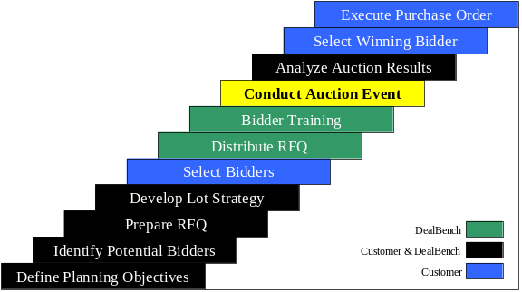
Conduct Auction Event
Suppliers
Buyer
Sourcing Experts
Deal Experts
Technology Experts
Training Reps
Customer Support

Slide 23
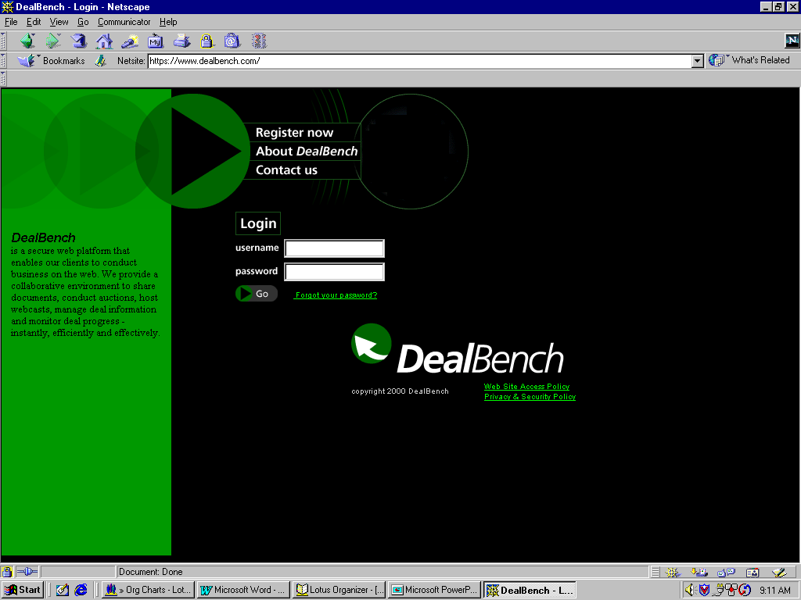
DealBench™ Sample Deal Demo

Slide 24
Suppliers
Auction Participation
Zero costs to bid in on-line event
No additional hardware or software required
Must have access to the Internet
Receive one-on-one training from DealBench™
Benefits
Gain understanding of existing marketplace
Have knowledge of exact market position in real-time
Total control over final bid submittal decision

Slide 25
Recent Procurement Deals
Recently closed a sealed-bid auction for leases resulting in total portfolio value in excess of $100MM
Conducted the first “live” auction in September, yielding savings of 17% for the customer
Auction pipeline currently includes ten events scheduled for 4Q2000, representing over $150MM in auction volume

